Slide 1
CMU 10-742 Machine Learning in Healthcare
Lecture 7: Paying for Health Care
Pamela Peele
Notes:
Last week or “escape velocity”

Slide 2
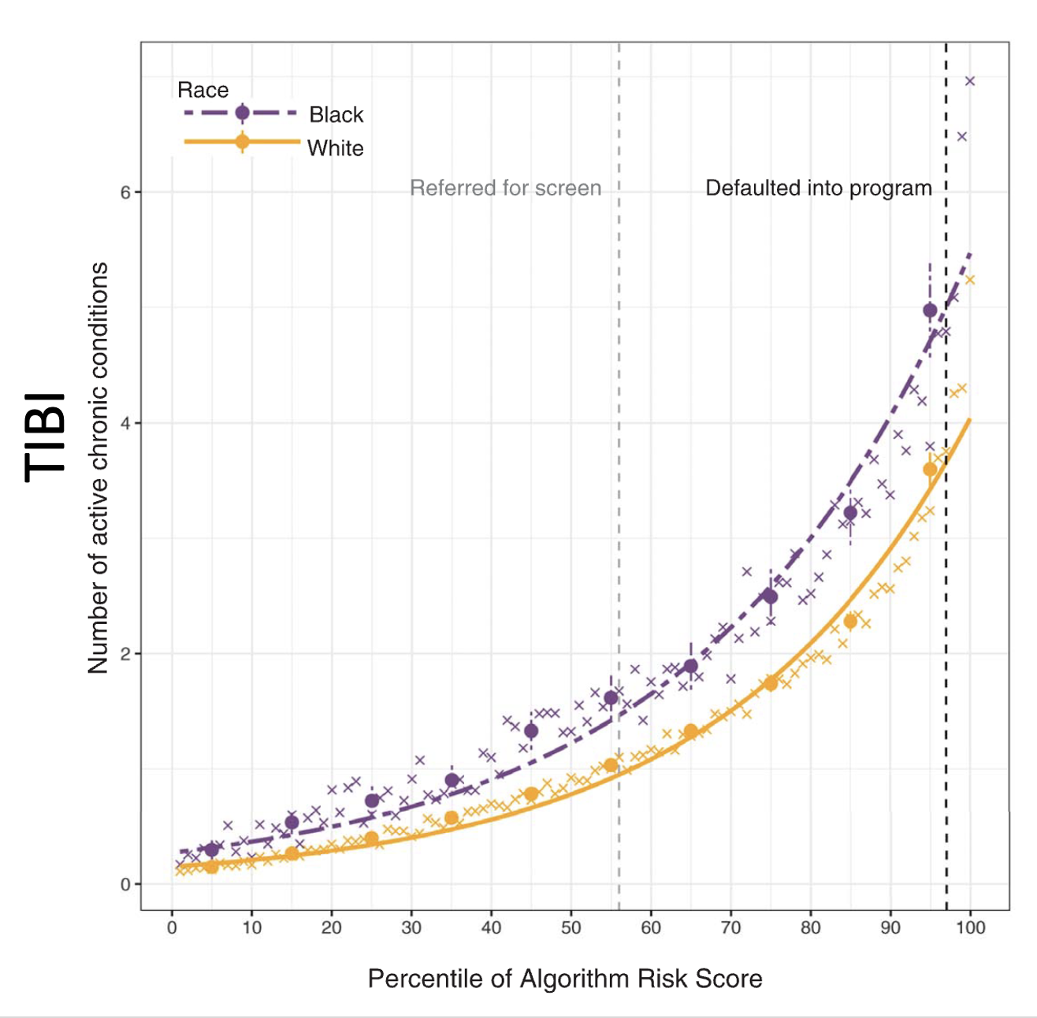
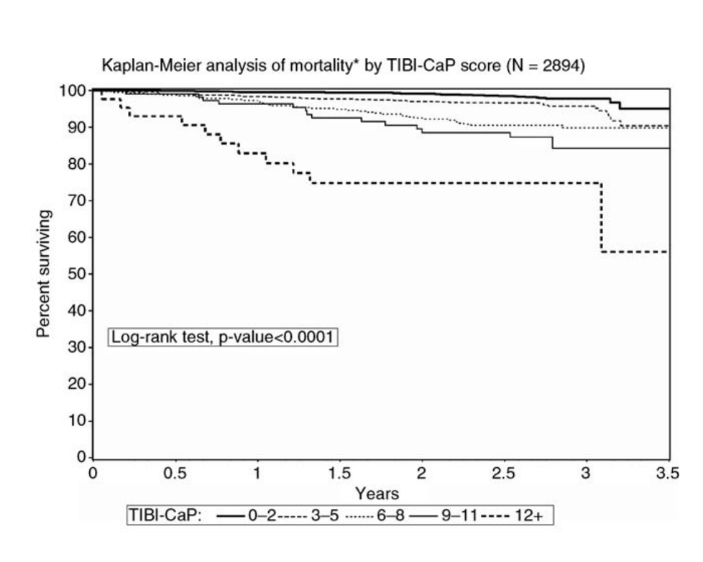
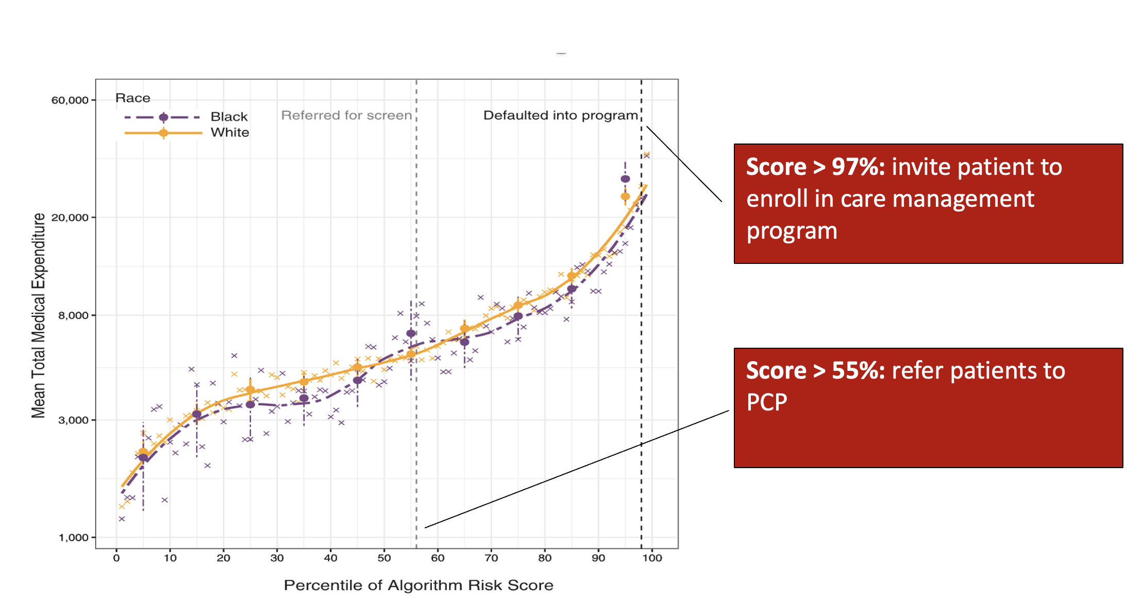
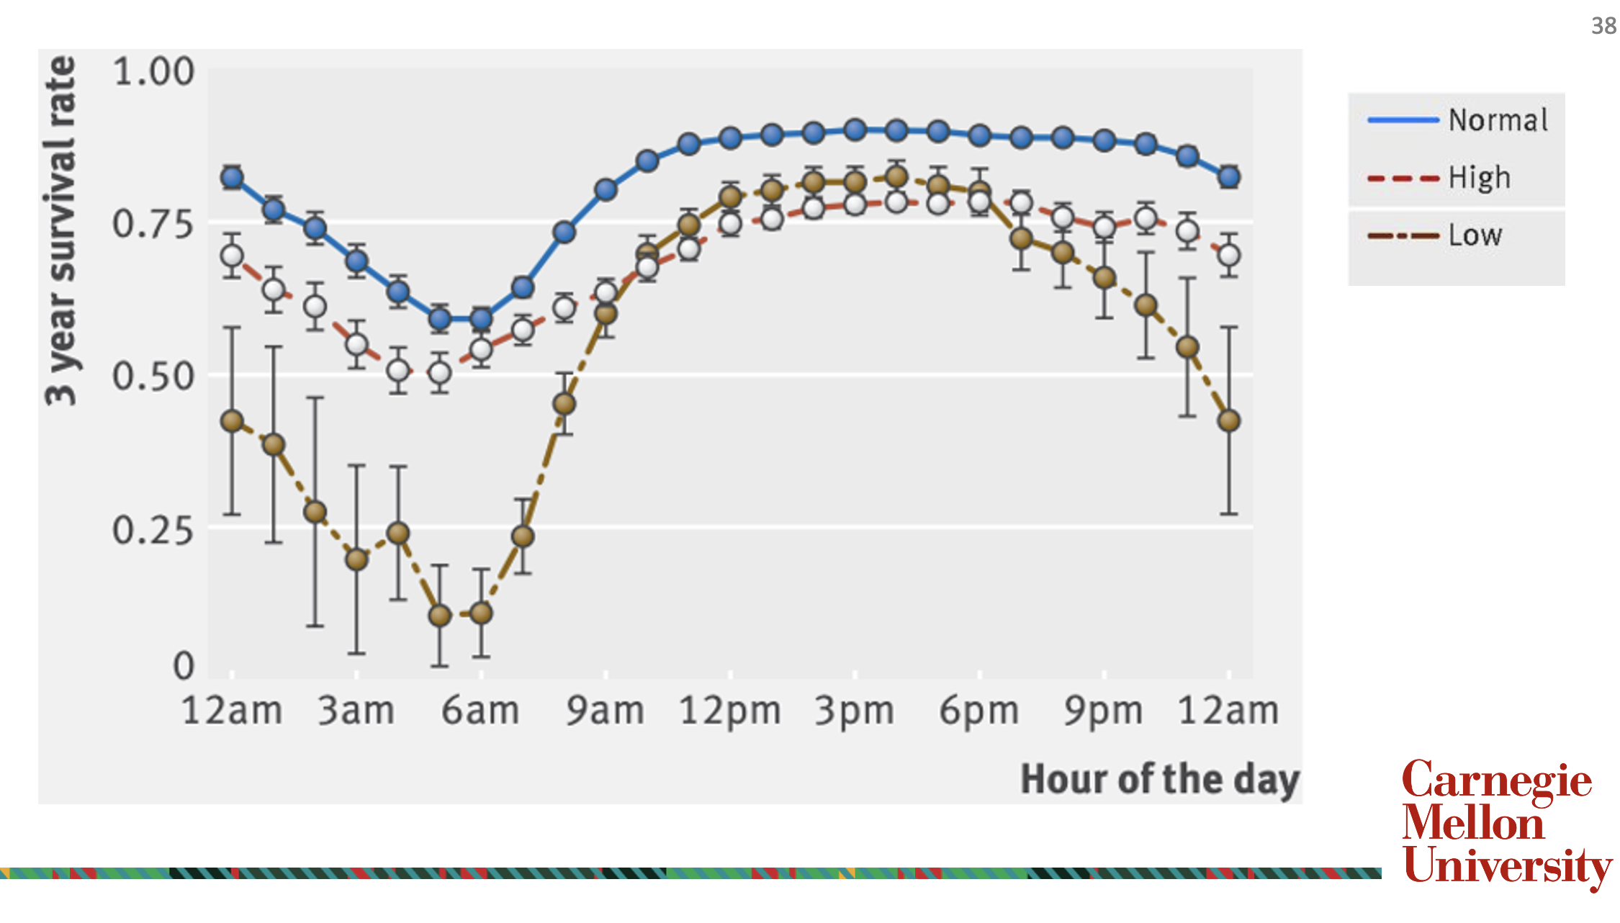
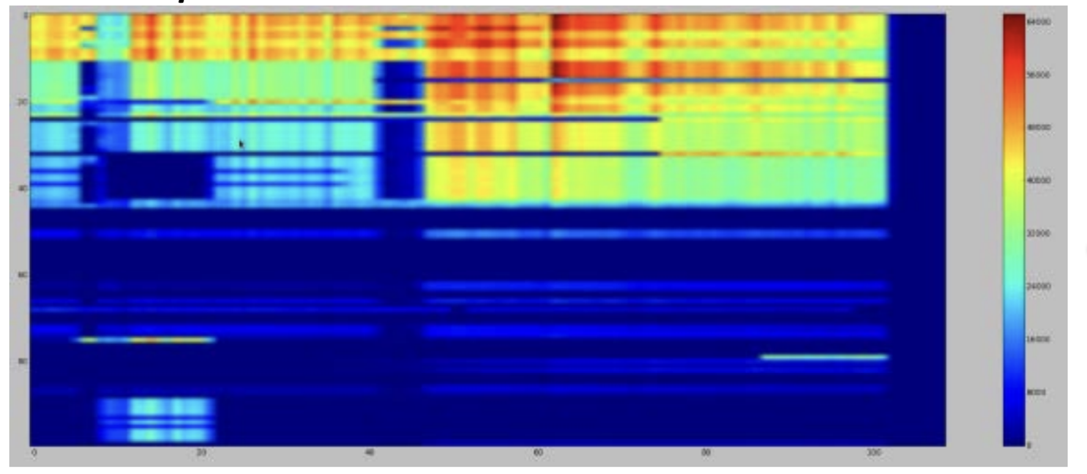
Lecture 6 Recap
LABEL SHIFT
COVARIATE SHIFT
Notes:
Top, L-R
(Obermeyer paper)
Cost vs. assigned risk score, plus 2 vertical lines
Middle: Kaplan Meier curve for different TIBI scores
Right: TIBI vs. assigned risk score.
Bottom, L-R:
(Kohane paper)
process bias
data shift – Narges Razavian – labs over 10 yrs
Two kinds of data shift

Slide 3
Course Logistics
Assignment 0 grading update
Assignment 1 grades are released
Assignment 2 due next Tues (Sep 24)
Final Project Milestone 1 is OCT 10 (syllabus has been fixed)
Notes:
No readings for next week, but there is homework!
Medicare shopping exercise due by Tuesday’s lecture
Look at Canvas

Slide 4
Financing Healthcare Applications to Machine Learning
Pamela Peele, PhD
Principle, Peele Consulting
Associate Professor, University of Pittsburgh
Former Chief Analytics Officer, UPMC

Slide 5
Pre-class assignment (Medicare Shopping)
September 17, 2024
Demand for healthcare services and insurance.….Government, State, Private insurance
How health care insurance influences common data sources
Common data sources and their structure
Inconsistency in Standardized Codes
Post Class assignment (Risk Premium)
September 19, 2024
Hard problems in healthcare
Risk Adjustment, Clinical Outcomes, Bundled Payments, Dynamic Protocol Development, Predicting Expenditures.
Post Class assignment (Model Proposal)

Slide 6
Policy, Politics, Finances
Social Determinants of Health
Framework, Principles, Theory
History
Health Insurance
Industry
Commercial
Employer
Government
Private
Federal
Workers
Comp
State
Self Insured
Military
Duals
SNP
HI Exchanges Market Place
Medicaid
CHIP
LTSS
Individual
Fully Insured
Medicare

Slide 7
Why this matters for machine learning
Understanding how care is paid for will guide you in how you use and interpret common medical data sources.
Hazards of treating medical encounters has homogenous transactions

Slide 8
We don’t sell Health
Health Transformation function
Insurance price
Risk aversion
Willingness to pay
Impact of all this on data

Slide 9
Health Transformation Function
Health
Health Services

Slide 10
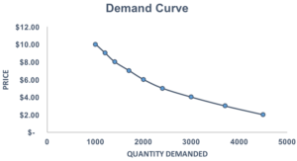
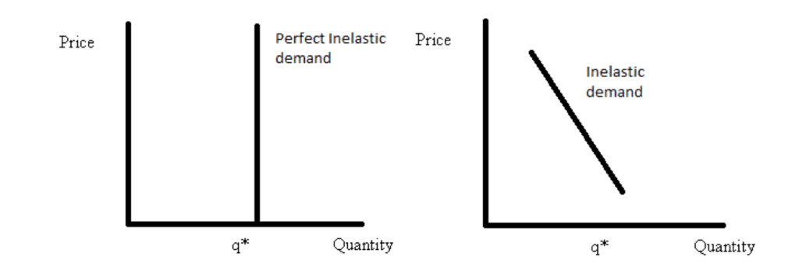
Complex demand functions

Slide 11
Insurance and Moral Hazard
Insurance reduces the price a consumer faces
This increases the quantity demanded
Creates a disincentive to
Care is consumed that has less value than the true price = moral hazard

Slide 12
Moral Hazard from Insurance
Change in economic behavior because insurance, in total or in part, shields a consumer from the full economic/financial consequences of their actions.
Welfare loss. Suboptimal allocation of resources because the price of health care does not equate to the actual cost of the resources to produce it. Impact of price changes….

Slide 13
Selling Insurance: Actuarially fair insurance
Premium (price of insurance) = Expected payout (price of claims)
There is no actuarially fair insurance market.
Admin cost

Slide 14
Willingness to Pay
Indifference point between having insurance and not.
Expected Util with and without insurance are equal. That’s the maximum someone will pay for insurance.
See https://www.youtube.com/watch?v=sWH4t5HoTXU for a nice step by step example of this.

Slide 15
Administration Costs
Claims Adjudication
Network/contract management (inc. reimbursement agreements)
Customer service
Claims coordination
Financial regulatory reporting
Quality reporting and premium adjustment
Legal resolutions

Slide 16
Expected Value and Expected Loss
Example at individual level
Person makes 100K/year
25% chance of illness which will cost 10k
Expected Value of Income = .75(100000) + .25(90000) = 98,500
Expected Loss of Income = 2,500

Slide 17
Diminishing marginal utility

Slide 18
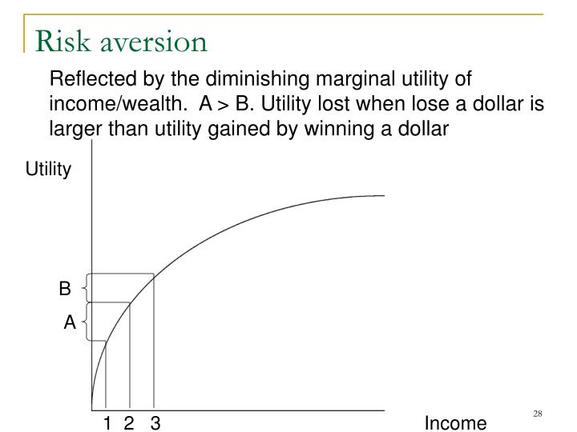

Slide 19
Risk Aversion: Diminishing marginal utility

Slide 20
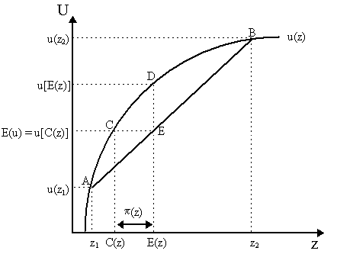
Risk Aversion: Diminishing marginal utility
U=Utility
Z=Income
C=Income Certainty

Slide 21
Willingness to Pay
Indifference point between having insurance and not.
Expected Util with and without insurance are equal. That’s the maximum someone will pay for insurance.

Slide 22
About Medicare
Medicare is a federal health insurance program for people who are:
Age 65 or older, OR
Under the age of 65 with certain disabilities, OR
In end-stage renal disease
Types of Medicare Coverage
Part A: Hospital coverage
Part B: Outpatient coverage
Part C: Medicare Advantage
Part D: Prescription Drug Coverage
Medicare Supplemental Plans (Medigap)
Special Needs Plans

